Slide 1
Medical product tracking using Bolckchain
PSCS222Capstone Project
Review-0
Batch Number:CBC-G05
Under the Supervision of,
Dr.Arshiya Lubna
Assistant Professor
School of Computer Science and Engineering
Presidency University
20211CBC0007 | R.Nani Naidu
20211CBC0008 | V.Pramod kumar
20211CBC0010 | S.Arshad ahamed
20211CBC0020 | K.Lokesh
Roll Number | Student Name
Name of the Program: Computer Science and Engineering
Name of the HoD: Dr.Pravintha Raja
Name of the Program Project Coordinator: Suma N.G
Name of the School Project Coordinators: Dr. Sampath A K / Dr. Abdul Khadar A / Mr. Md Ziaur Rahman

Slide 2
Content
Problem Statement
Github Link
Analysis of Problem Statement
Timeline of the Project
References

Slide 3
Problem Statement Number:PSCS222
Organization: Robert Bosch Engineering
Category (Hardware / Software / Both) : software
Problem Description:Global supply chains have expanded commerce but increased complexity, requiring collaboration among various parties. Ensuring visibility into asset origin, authenticity, and handling is a challenge for retailers and manufacturers. When problems arise, identifying faults and customer impact is crucial. Blockchain technology, as a secure, distributed ledger, provides trust and transparency by allowing parties to track assets across the supply chain and securely share provenance and handling information.
Difficulty Level: Medium

Slide 4
Github Link
The Github link provided should have public access permission.
Github Link:
https://github.com/Nani-Naidu/Zeroth-review

Slide 5
Analysis of Problem Statement (contd...)
Software and Hardware Requirements:
Block chain wallet
Remix ide
Front end

Slide 6
Analysis of Problem Statement (contd...)
Supply chains lack transparency, consistency, and trust due to fragmented data and limited visibility across multiple parties. This results in difficulties tracking goods, resolving issues, and ensuring compliance. Blockchain offers a secure, decentralized solution for real-time data sharing, enhancing trust and accountability.

Slide 7
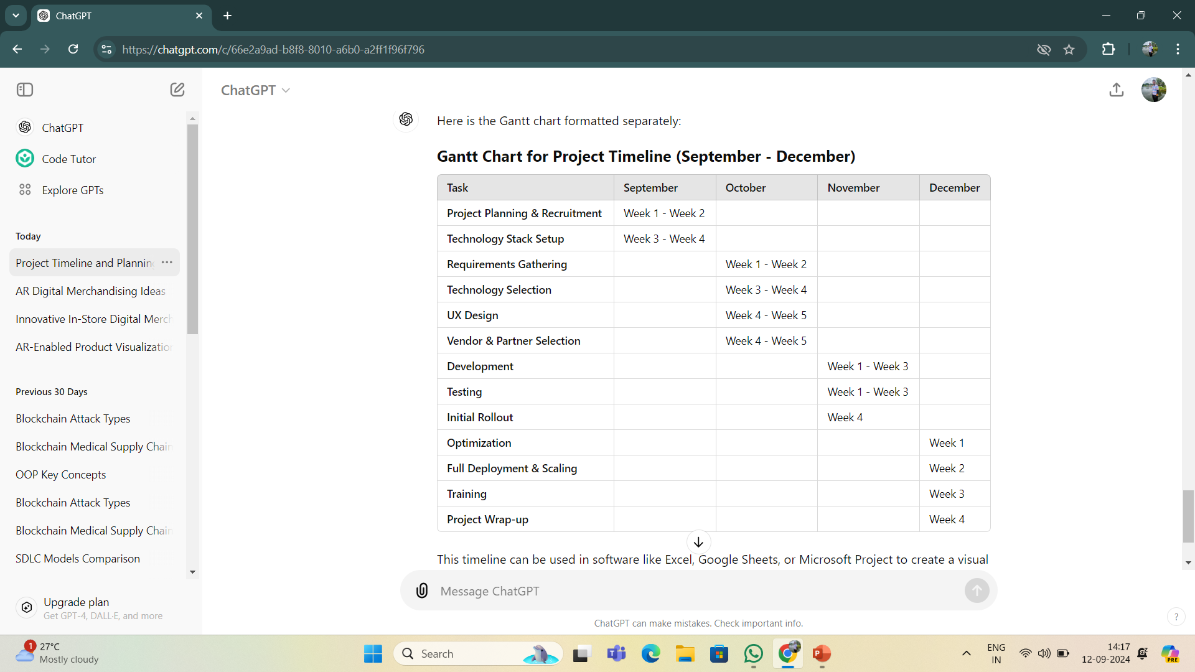

Slide 8
References (IEEE Paper format)

Slide 9


